Slide 1
EE 1520 計算機概論二 （一一三學年下學期） Introduction to Computer Science (II) Slide Set 04
S. Felix Wu
sfelixwu@gs.ncku.edu.tw
https://github.com/sfelixwu/ee1520
https://www.youtube.com/@sfelixwu
https://discord.gg/PrJKQsKT

Slide 2
JSON
Object Data Description
Procedure Programming vs Object-Oriented Programming

Slide 3
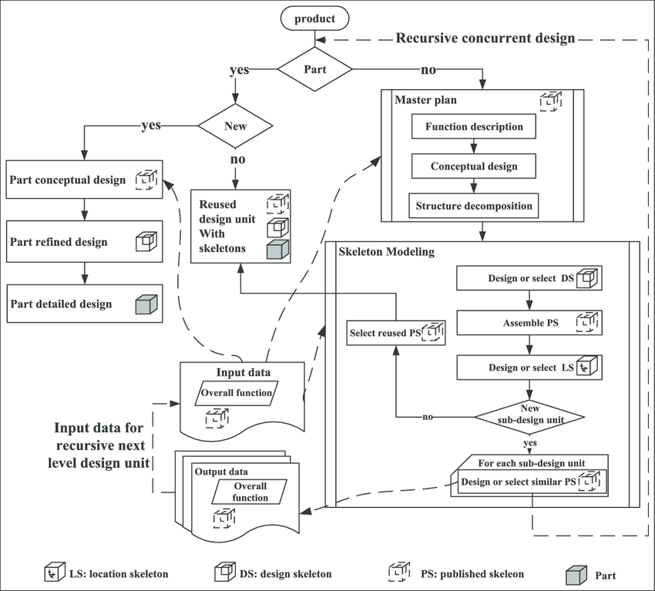
Control-Flow
driven
Data-driven
Data Abstraction
driven
Modeling the data naturally as what they really are and their semantic impacts

Slide 4
Two paradigms
Focusing on Control Flow (and Algorithms) to solve a specific problem
Focusing on Modelling of the Objects in the target application domains, representing the properties about the objects, then these Object designs might be used to solve most, of not all, of the problems in the domains.
reusability and revisions

Slide 5
Two sides of OO*
Complexity of the Problem itself
Solving real problems!!
Better Software Development

Slide 6

Complexity of the Problem itself
Solving real problems!!
Better Software Development

Slide 7
GPS_DD Object in JSON
{“latitude”: 38.53, “longitude”:-121.74}
How about the behavior about these data?
Example – distance( )
Behavior ➔ a, usually, small program to read or modify the Data
Objects are active and alive

Slide 8
Type
What type of objects are these?

Slide 9


Slide 10
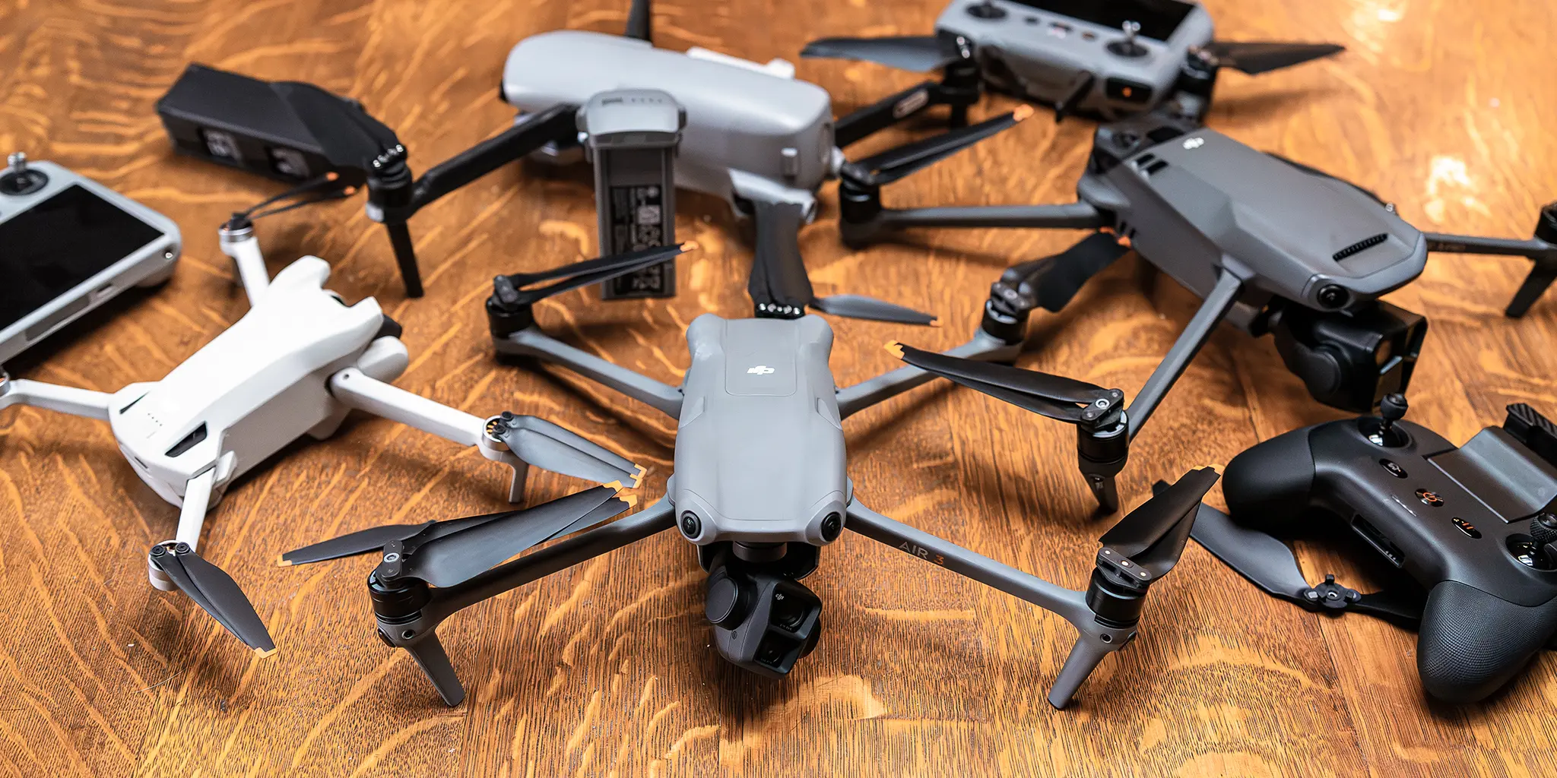

Slide 11
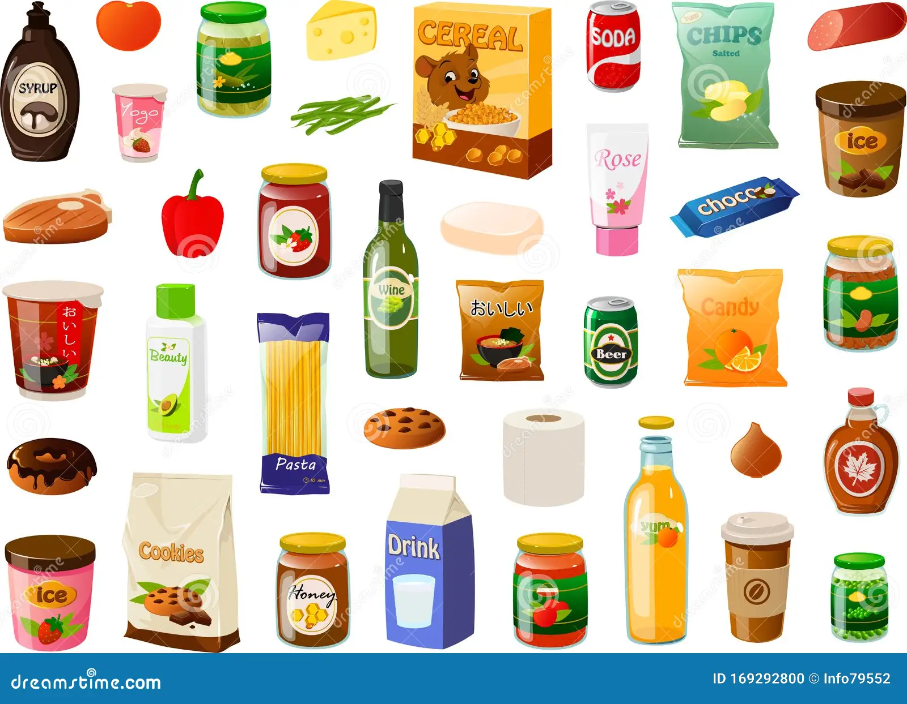

Slide 12


Slide 13
A certain type of objects
C++ ➔ Class
A common framework/specification to a certain type of objects, and their destinated behaviors

Slide 14
OO Principles
Data Abstraction
Polymorphism
Inheritance
Encapsulation

Slide 15
OO Programming in C++
Data Abstraction
Polymorphism
Inheritance
Encapsulation
class GPS{…}
latitude
longitude
https://github.com/sfelixwu/Person_and_Thing

Slide 16
Objects/Classes
Data/attributes
Internal, external, inherited/protected
Methods (interface, member functions)
External, internal, inherited/protected, virtual

Slide 17
Objects/Classes
Data/attributes
Internal, external, inherited/protected
Methods (interface, member functions)
External, internal, inherited/protected, virtual
class class_name
{
private:
…
…
…
public:
…
…
…
};
latitude
longitude

Slide 18
Objects/Classes
Data/attributes
Internal, external, inherited/protected
Methods (interface, member functions)
External, internal, inherited/protected, virtual
class class_name
{
private:
…
…
…
public:
…
…
…
};

Slide 19
GPS.h GPS.o
Separate Compilation
class GPS_DD
{
private:
double latitude;
double longitude;
public:
explicit GPS_DD();
explicit GPS_DD(double, double);
double getLatitude();
double getLongitude();
double distance(GPS_DD);
void dump();
};
GPS_DD Nitin;
Nitin.dump();

Slide 20
Object-Oriented Paradigm
Object-oriented analysis and modeling
Object-oriented design
Object-oriented programming
Object-oriented languages/constructs

Slide 21
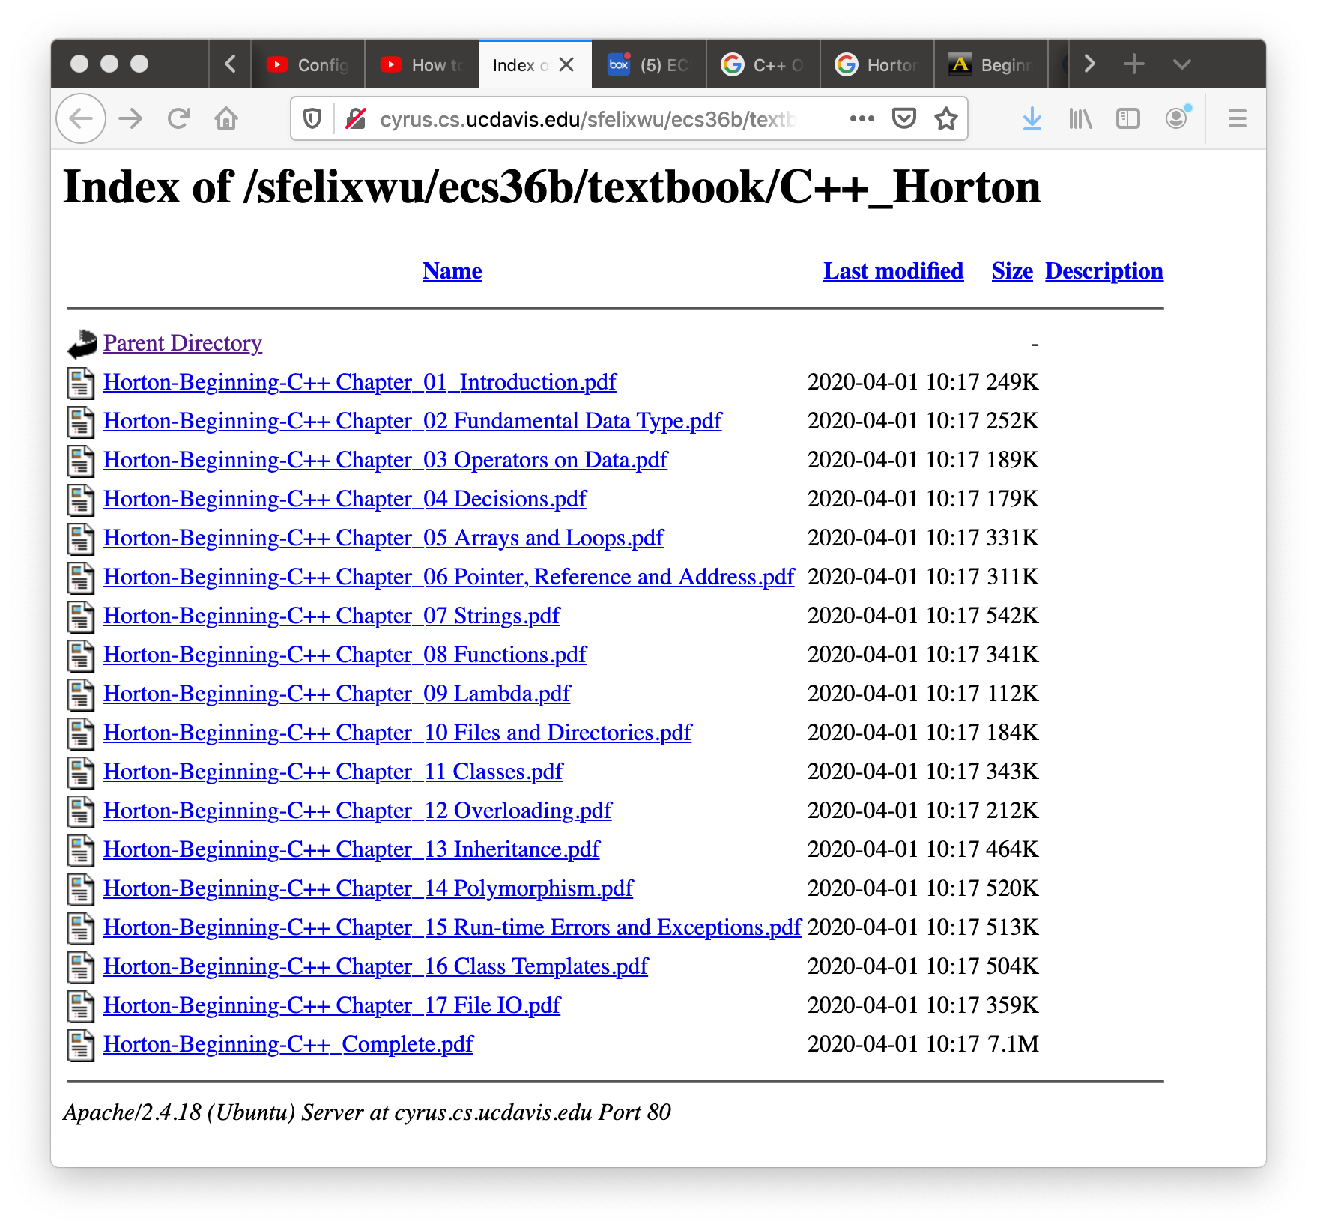

Slide 22
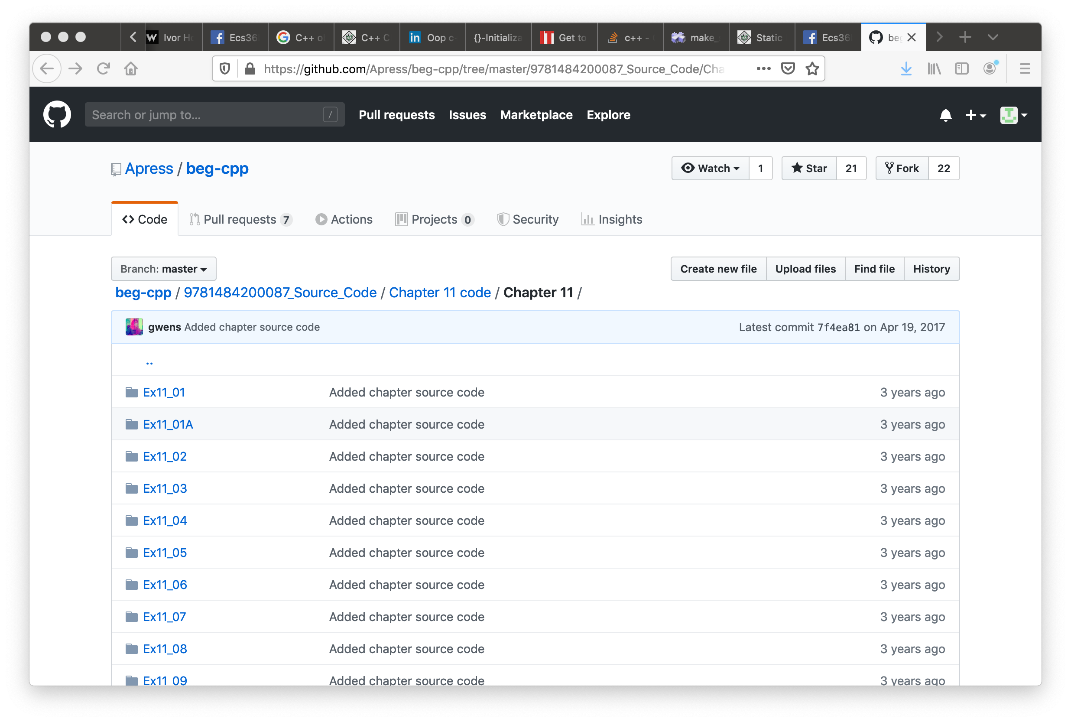

Slide 23
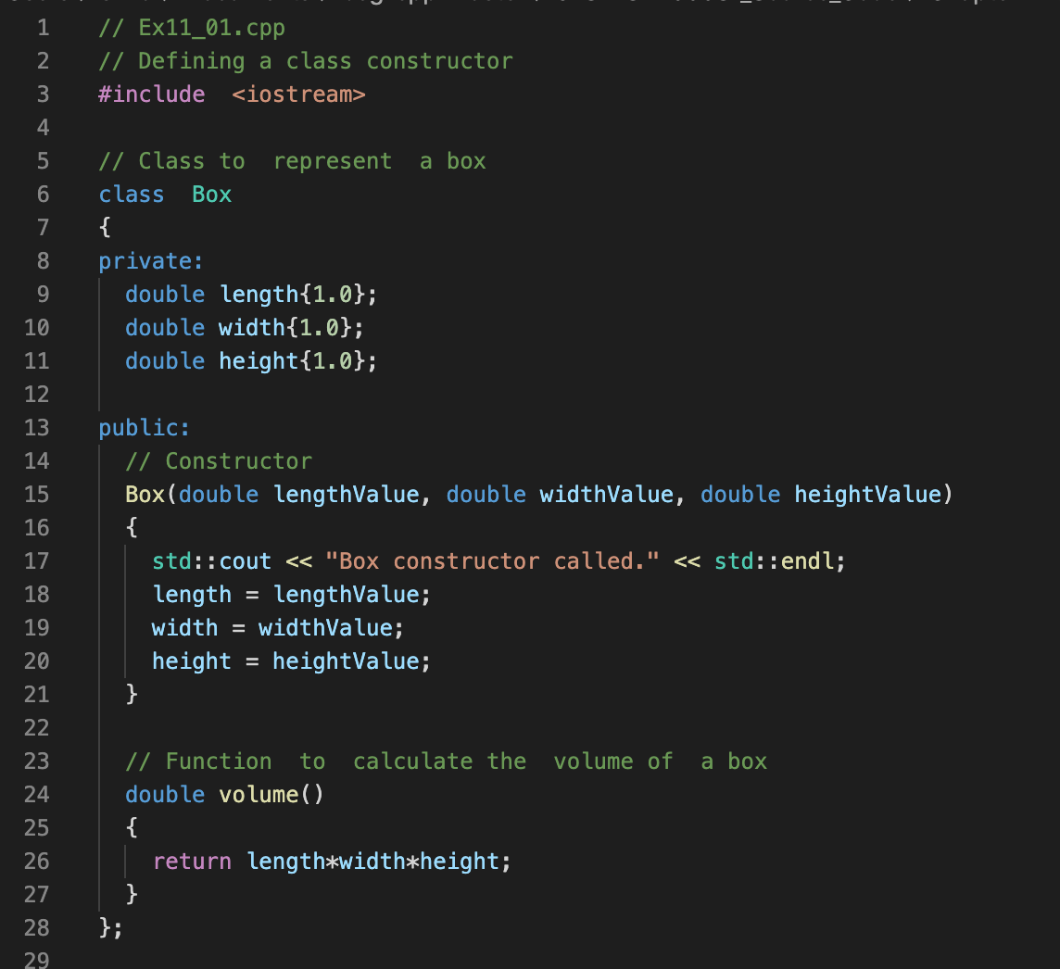

Slide 24
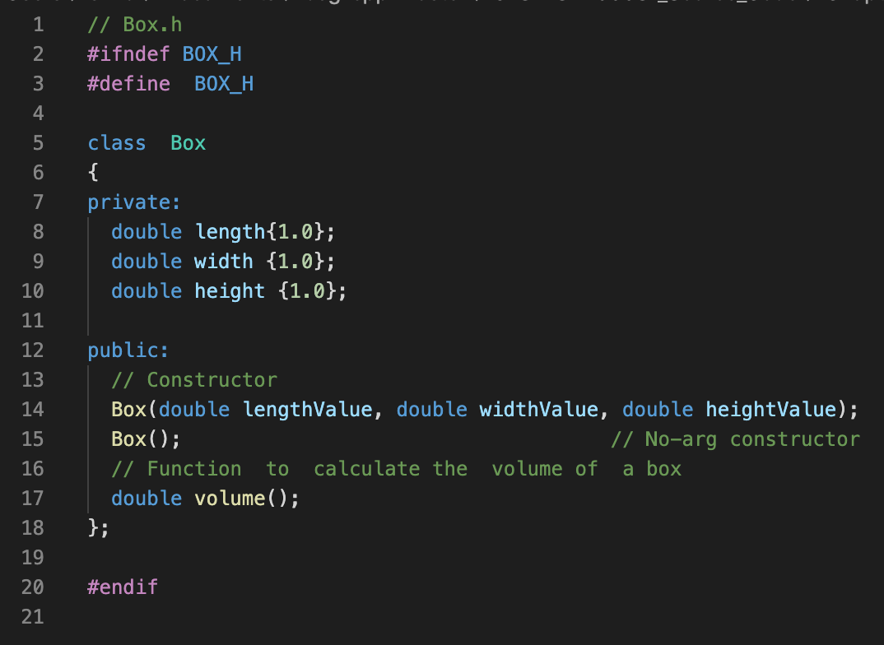

Slide 25
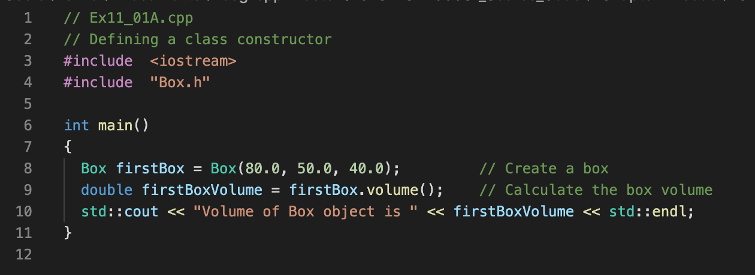
class Box;
C++ class, private and public
member functions
Constructors
V
length
width
height
C
C

Slide 26
class Box;
C++ class, private and public
member functions
Constructors
V
length
width
height
C
C

Slide 27
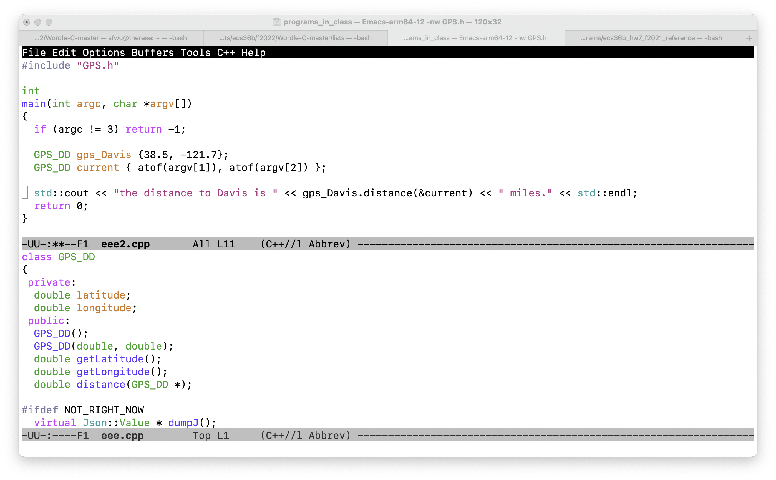

Slide 28
Function signature
Function name
Return data type
Input arguments and their data types.

Slide 29
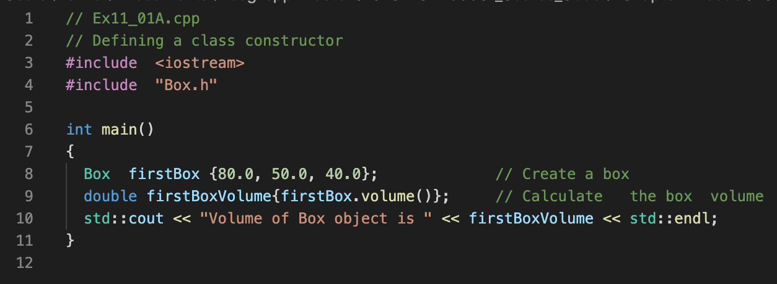
Felix’s version
Horton’s version

Slide 30
Felix’s version
Horton’s version

Slide 31
{ } Bracket Initialization
Available only after C++11
C++98 C++03 C++11 C++14 C++17 C++2a
g++ -std=c++2a Ex11_01A.cpp Box.cpp -o Ex11_01A

Slide 32
class Box;
C++ class, private and public
member functions
Constructors
Bracket Initialization
Namespace (Chapter 1, Horton)
V
length
width
height
C
C

Slide 33
Let us run some C++ programs!

Slide 34
double distance_calculated;
distance_calculated = gps_Davis.distance(current);
distance_calculated = gps_Davis.distance(GPS_DD {atof(argv[1]), atof(argv[2])});
distance_calculated = gps_Davis.distance({atof(argv[1]), atof(argv[2])});
distance_calculated = gps_Davis.distance({});

Slide 35
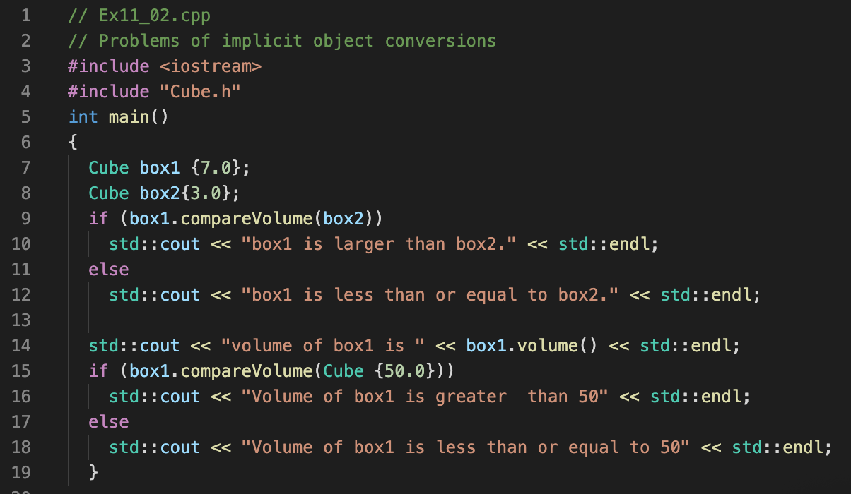
Good or bad?

Slide 36
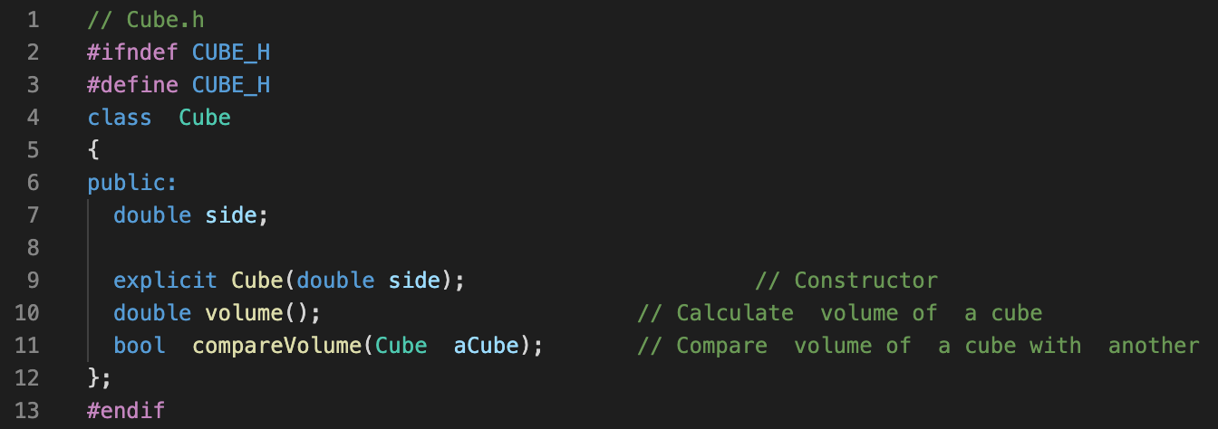
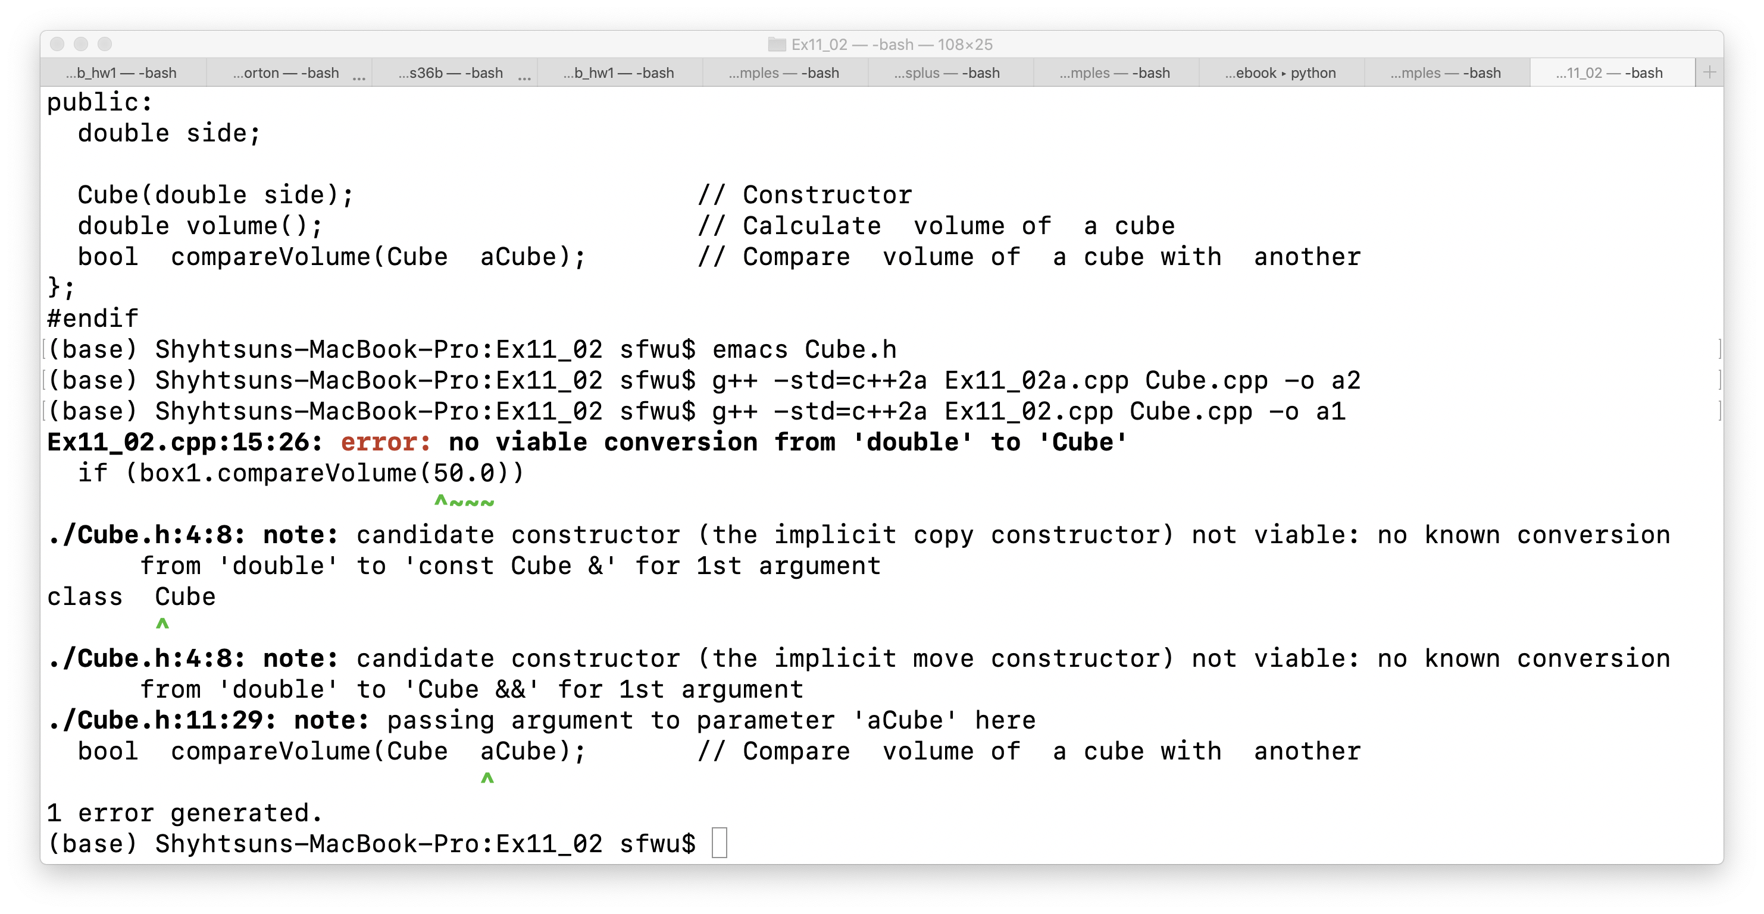

Slide 37
V
length
width
height
class
C
C
Can we track easily how many objects from this class have been created?
objects

Slide 38
V
length
width
height
Class Transaction
static variable
C
C
Can we track easily how many objects from this class have been created?
objects

Slide 39
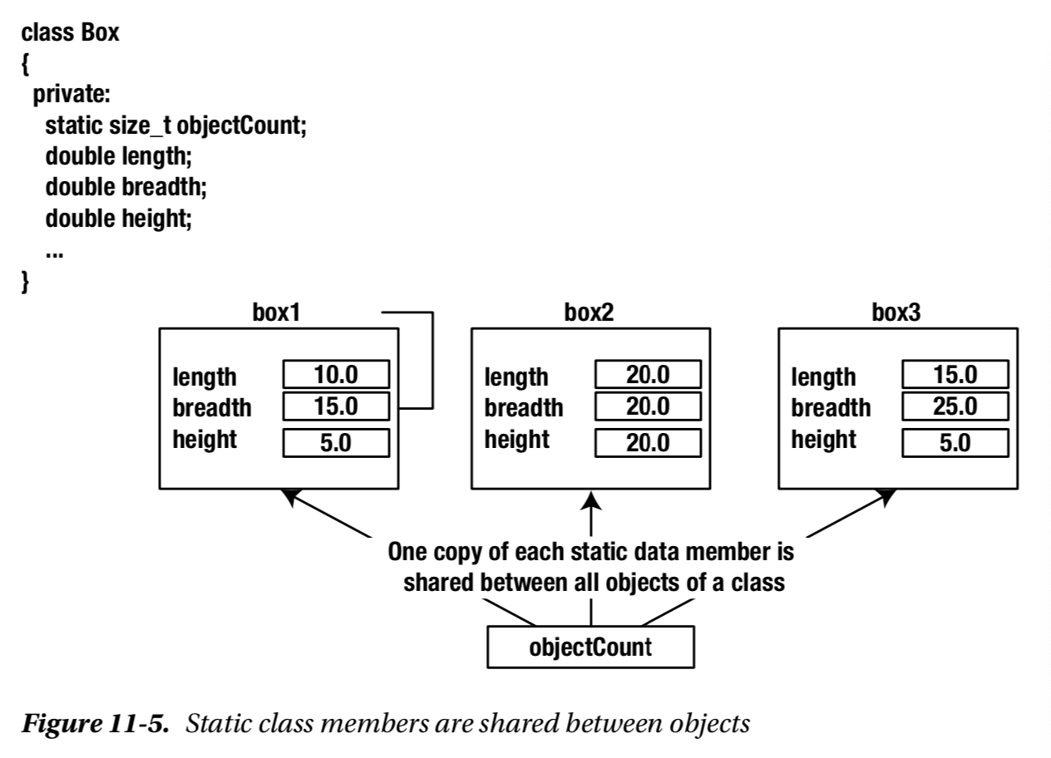

Slide 40
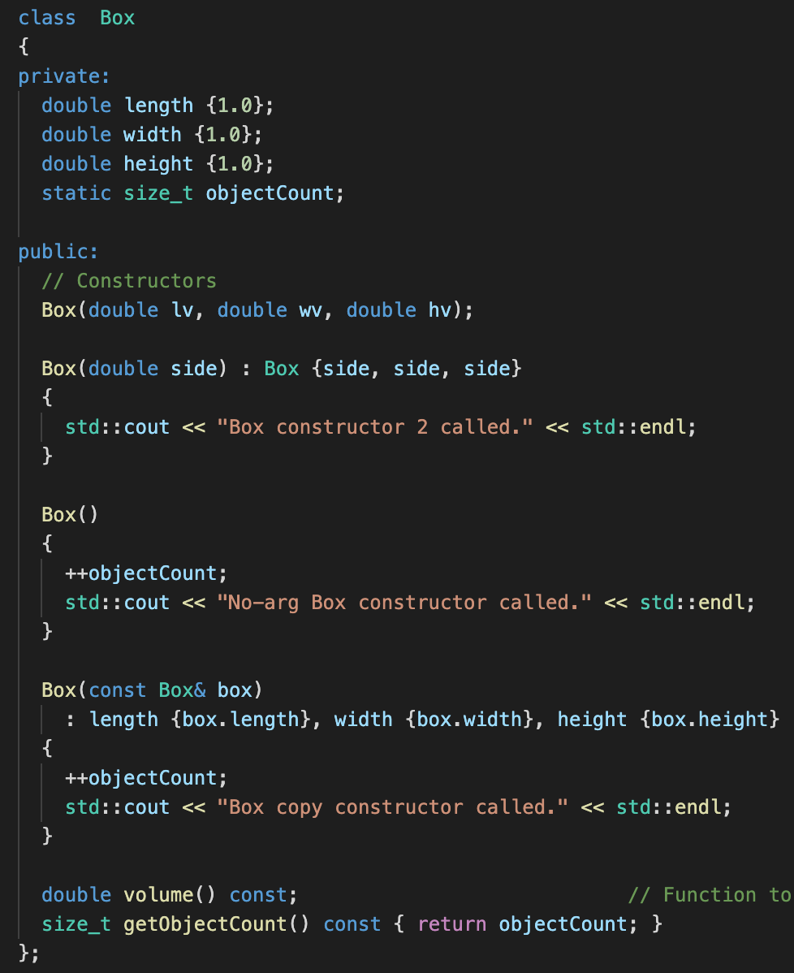

Slide 41
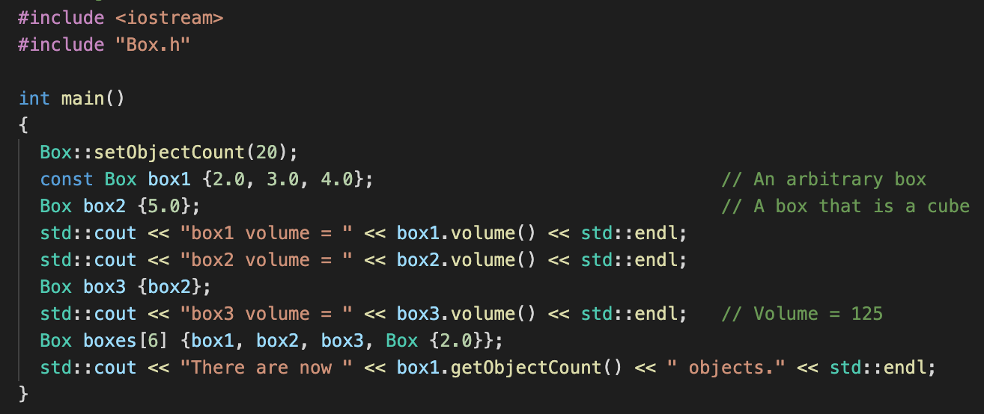
Accessing static variables before any object created

Slide 42
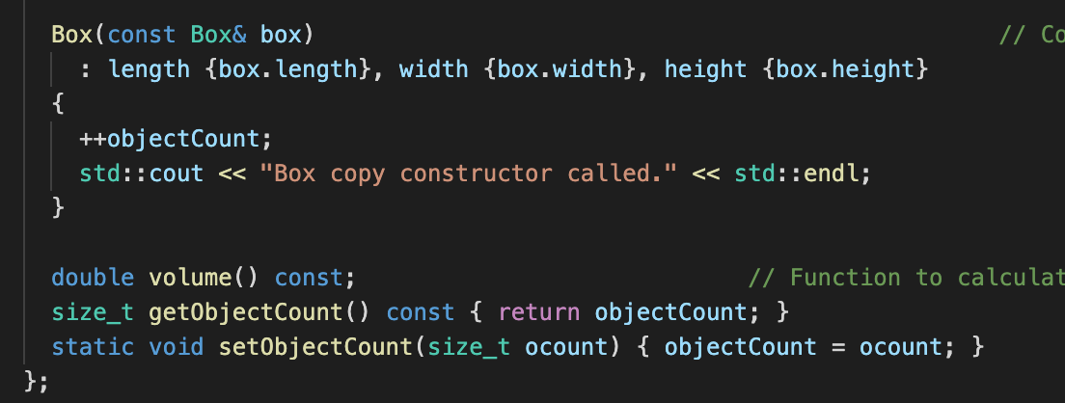
Box.h

Slide 43
#include "Transaction.h"
unsigned int Transaction::transaction_count { };
// unsigned int transaction_count = 0;
Transaction::Transaction(unsigned int arg_type)
{
Transaction::transaction_count++;
this->tr_type = arg_type;
}

Slide 44
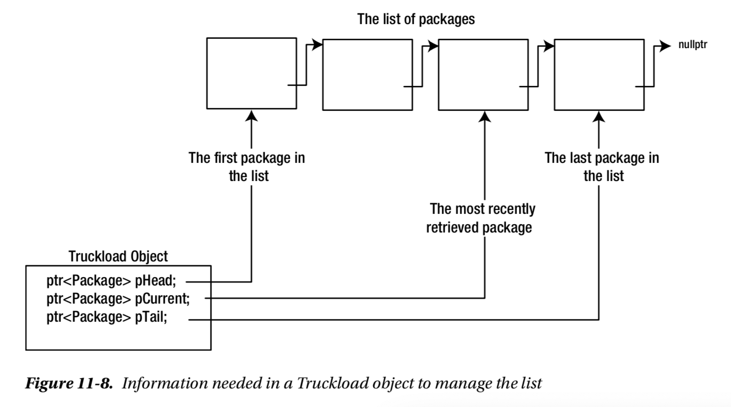

Slide 45
An Object
Integrity/Protection
Reusability
Abstraction

Slide 46
Two sides of OO*
Complexity of the Problem itself
Choosing the right-level of abstraction
Solving real problems!!
If you haven’t written the program, you don’t know what you are talking about!
Better Software Development

